Slide 1
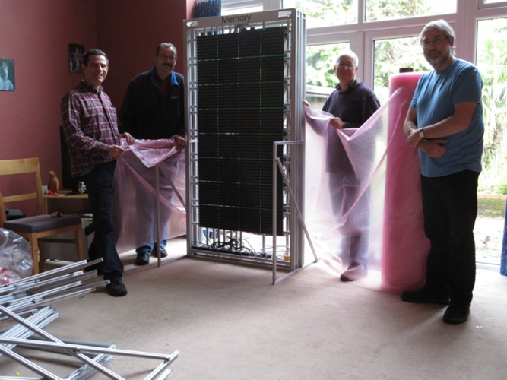
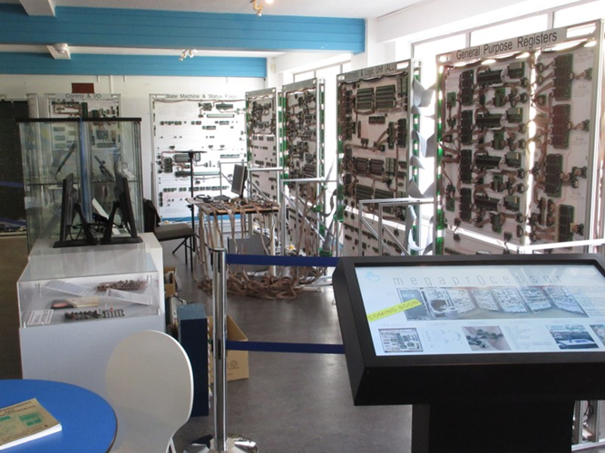
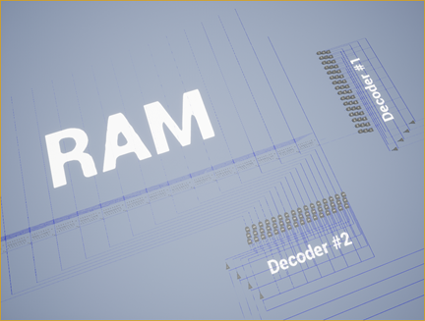
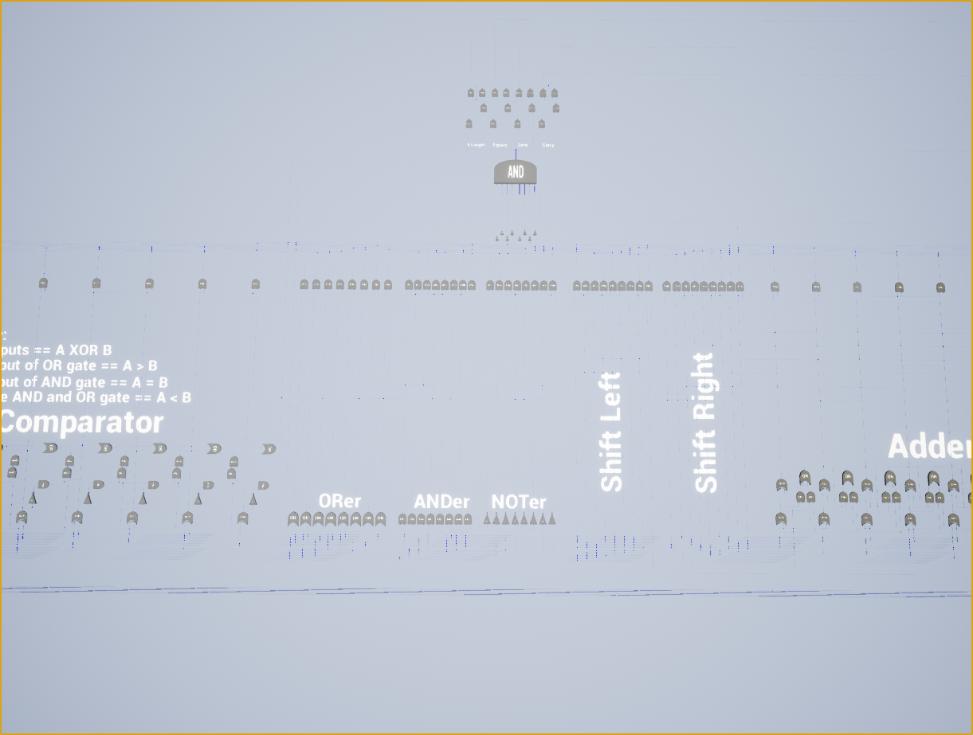
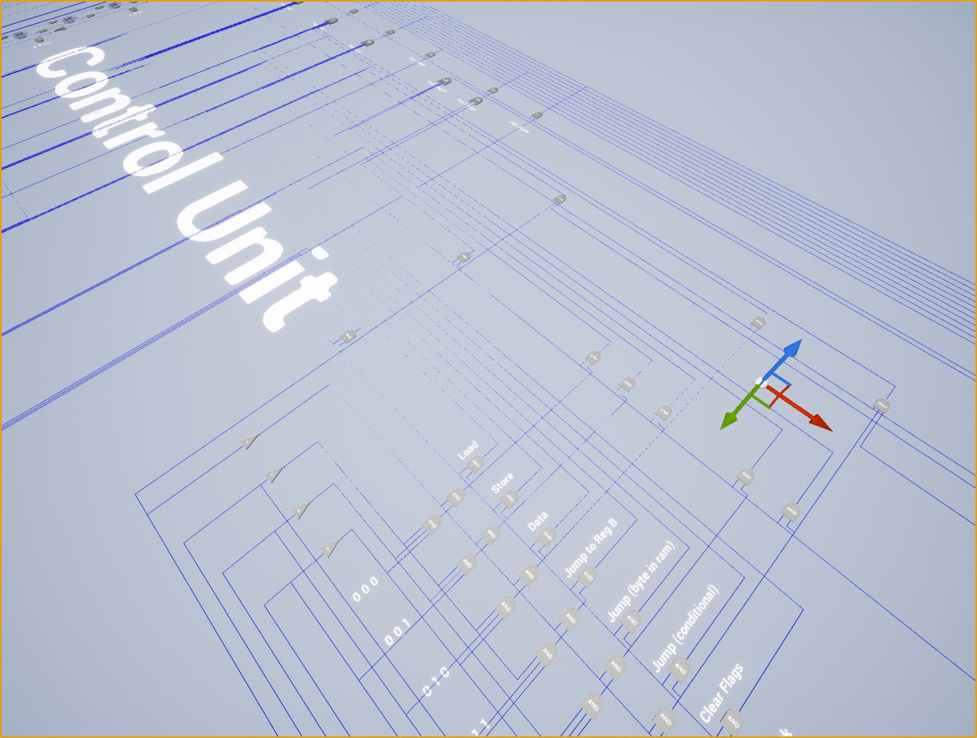
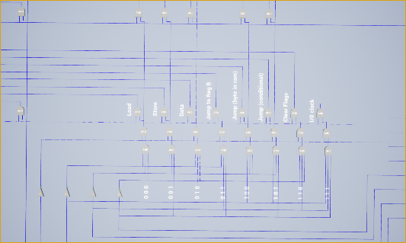
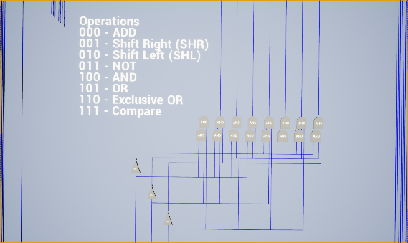
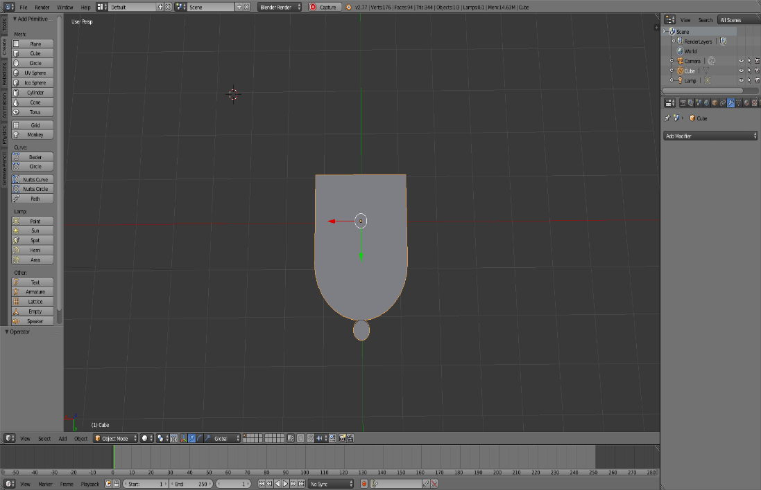
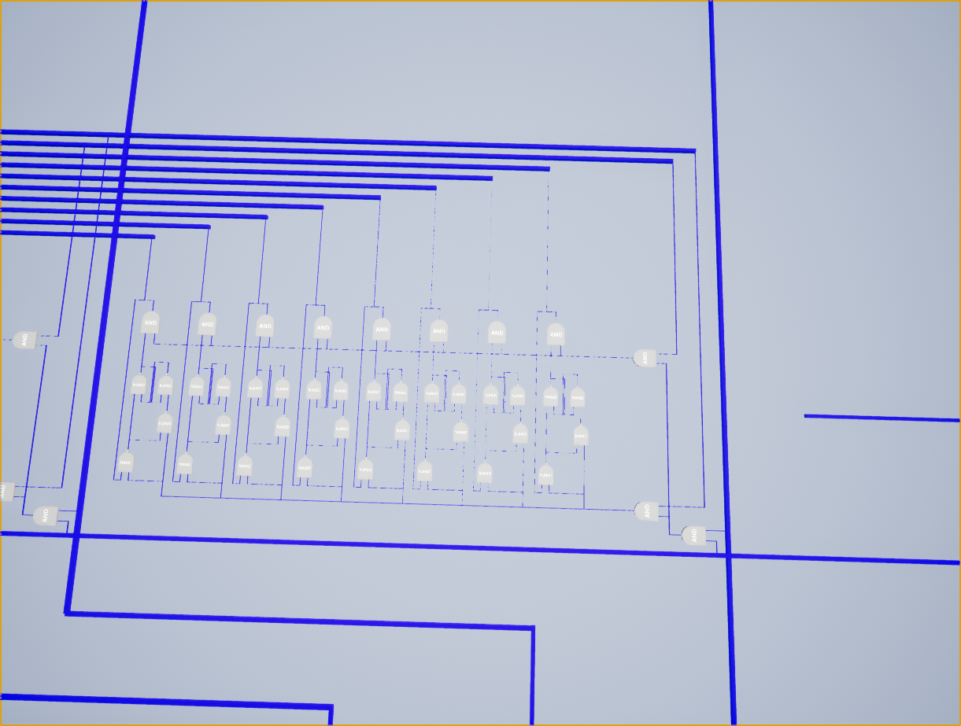
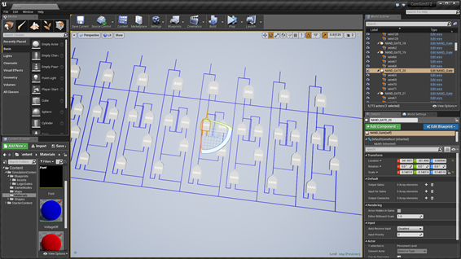
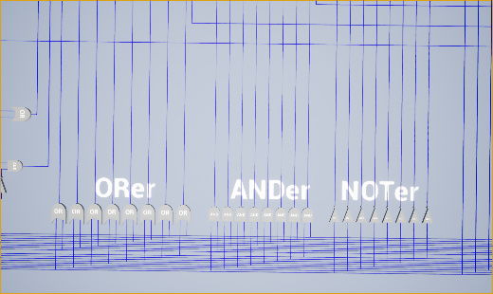
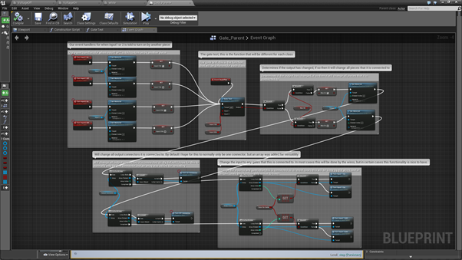
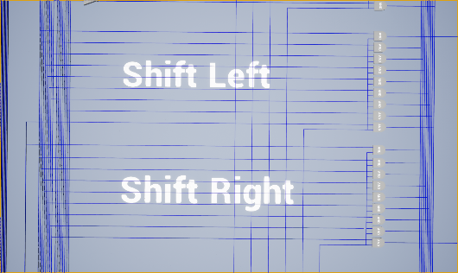
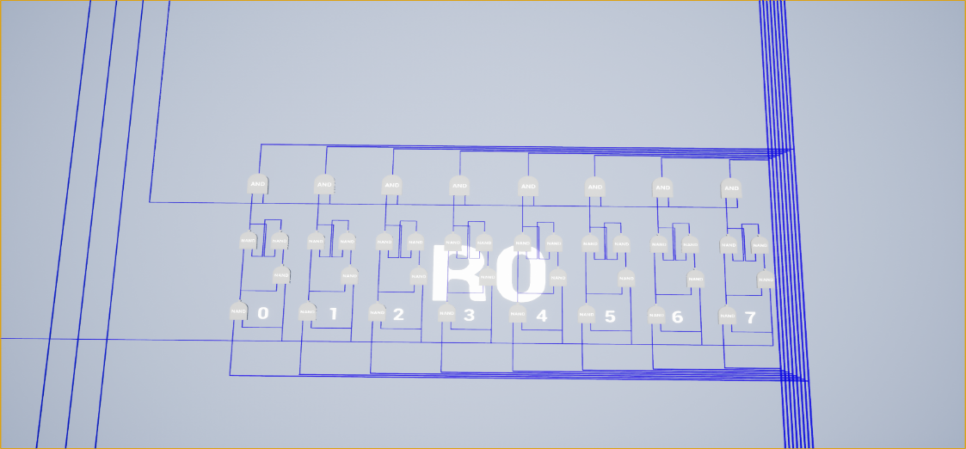
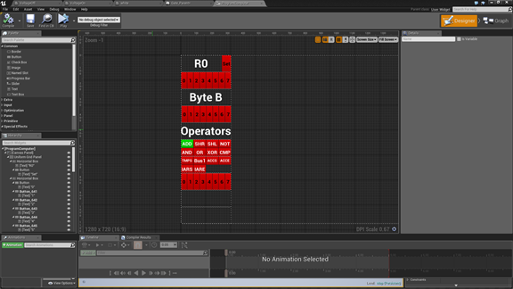
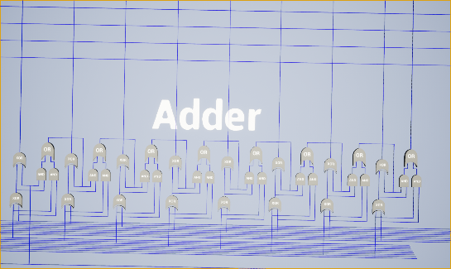
3D Computer Simulator
Trevor Bostic
Bridgewater College
Motivation
Learning and Planning
Programming the Gates and Wires
At this point we have discussed what all of the pieces do and how they operate together, but we have only briefly touched on how I programmed the gates and wires to simulate the flow of electricity. To simulate the flow of electricity I used an algorithm called flooding. While creating circuits, I would manually tell each gate and wire which other gates and wires it was connected to. Any time the specific object would undergo a state change (e.g. going from off to on) it would push the change to all of the components that it was connected to. While I believe this is the best algorithm for this situation, there are still a few flaws. The first problem I encountered was infinite loops. To fix the infinite loop problem, I had to make sure each component would always check to see if it had changed it’s state before pushing the changes. For example, if a wire were to change state and push the change to another wire, it is entirely possible that wire would turn around and try to push its change back to the first wire. However, since the first wire had already changed state, we have to make sure that it does not attempt to change state again and again indefinitely. The second, and more difficult problem was sequential logic. In real life, electricity flows everywhere simultaneously, allowing the electricity to change multiple circuits simultaneously. However, due to the structure of modern computers, I am only able to change the state of one piece at a time. Thus a small error such as turning one piece on before another is sometimes enough to cause a bug. In some special cases, I had to create specialized wires and gates that could change their order of execution in order to achieve the desired result. While I believe I have sorted most of these errors out, there are still a few lurking that I would expect to run into with further testing.
As a computer science major, I have always wanted to understand how computers work at a physical level. In my classes we have learned to program, but only in languages that someone else created, typically termed “high level languages”. While these languages will allow you to do many things with a computer, they never show you what computers are actually doing. These higher-level languages must go through a process of translation and compilation before they eventually arrive at the byte code that computers can understand. My honors project is an attempt to break the veil between a computer program on a screen and what a computer is doing behind the scenes.
Before I began designing any part of the computer simulator, I had to learn how computers work. My main resource in this endeavor was the book But How Do It Know? by J. Clark Scott. This book provides an in depth beginners guide in the physical workings of computers. The book begins by introducing the reader to the basic logic gates such as the AND, OR, and NOT gates. From this starting point, the book then begins to create larger and more complex circuits, often combing multiple previous circuits to build a new one. By the end you have created all of the circuits in the computer and all that is left to do is to make them work together. While certainly not a guide that would be useful to any experienced engineer, it provided nearly everything I needed to understand how to make my computer simulator function correctly. In the book, the author broke down a computer into three basic parts: RAM, ALU, and the Control Unit. Each of these pieces is shown below.
Simulated Computer Specs
Newman (on the left), moving a piece of the Megaprocessor to the museum.
Random Access Memory (RAM)
Arithmetic Logic Unit
Control Unit
The Future
The idea for this project was inspired by an engineer at Oxford University named James Newman. Newman built what he calls the Megaprocessor. Essentially, it is a 16-bit computer blown up in size so that people can walk though it and look at how it works. To show the flow of logic, Newman set up LED’s to turn on when a specific bit was turned on. Thus, you can follow the logic of the system by watching the flow of LED’s. Despite his massive achievement, there is one large problem with his project: it is not readily available to people. To go see it, you must go to a museum in Cambridge. Additionally, you would have to spend hours watching it before you would even begin to understand what it was doing. My solution to this problem was to create 3D computer simulation in a video game that would be available for download to anyone on the internet. My goal was to allow people to execute computer instructions, and then “fly around” and watch the machine as the command was executed. Even better, the computer only cycles when you want it to, meaning that you can look at a specific state for any period of time. Taking all of these things into consideration, I decided to build an 8-bit computer simulator that contains the three major parts of a computer: the Arithmetic Logic Unit (ALU), Control Unit, and RAM.
While the computer is now fully wired and connected, there are still a couple flaws that stop it from being useful for beginners. Currently there is no good way to input binary instructions into the computer. All that has been set up is a testing interface so that I can test the instructions, but nothing that is nice or friendly to look at. Similarly, there is no way to determine what the output is besides reading the byte code stored in the registers or the RAM. Lastly, there is no tutorial in the game. As soon as it starts you are thrown into an entire 8-bit computer. These issues essentially make the game useless for beginners. It is my hope in the future to implement a level type system into the game. These levels would begin with basic circuits, and allow the user to play around with the inputs to see what happens with the output. As the user would progress through the levels, the circuits would become more and more complex. The current state of the project would be the last level; a fully completed computer that the user can watch run commands from start to finish. Since I am now finishing my undergraduate degree, I may also look for other developers that are more experienced in Unreal Engine and are willing to help design the user interface and update the rather lackluster models that I am currently using.
The Megaprocessor as displayed in the museum.
Decoder circuits used to select a specific byte of RAM for writing or reading
A wide view picture of all of the ALU operations
A wide view picture of the Control Unit
Logical Truth Tables
Within the ALU are eight different arithmetic and logical operations that can be performed on the 8-bit inputs. These operations are: XOR, OR, AND, NOT, Shift right, Shift Left, Add, and Compare. Each of these circuits is pictured and labelled below. To select a specific operation, you must enter the correct byte code into the ALU’s decoder circuit.
There are also seven different operations you can perform using only the computers Control Unit. These operations are: LOAD, STORE, ENTER DATA, three different ways to JUMP, and CLEAR FLAGS. In both the Control Unit, you must pass the correct byte code to the decoder circuits to select the instruction you wish to execute. Pictured below are the decoder circuits for both the Control Unit and Arithmetic Logic Unit.
Throughout this poster, you will see many mentions of the logical operations such as AND, OR, and NOT. Below are the truth tables to all of the logical functions. These truth tables will show you how the operation evaluate given a specific input. If you have any questions please ask.
My simulated computer is an 8-bit computer, which implies that it can have a maximum of 256 bytes of RAM. Originally, I had intended to make this much RAM, but unfortunately due to the constraints of computer power I was only able to make sixteen bytes. Though RAM is extremely repetitive, it is also very costly in terms of logic gates and wires. Each bit needs at least four gates and seven wires. Thus, each byte would require thirty-two gates and fifty-six wires. Even at only sixteen bytes, this means that within just the RAM, 512 logic gates and 896 wires are required. Using any more than this begins to cause frame-rate problems during gameplay.
AND
OR
NOT
3D Modeling and Development
The Comparator circuit shown to the left actually performs two of the ALU’s operations simultaneously since the Compare operation inherently uses the XOR operator. The first operation that it can be used for is a simple logical XOR of the bits in the input. Using the output from the XOR, we can also compare the two inputs and determine if one is greater than the other, or if they are equal.
Input 1 | Input 2 | Output
0 | 0 | 0
0 | 1 | 0
1 | 0 | 0
1 | 1 | 1
Input 1 | Input 2 | Output
0 | 0 | 0
0 | 1 | 1
1 | 0 | 1
1 | 1 | 1
Input 1 | Output
0 | 1
1 | 0
The first step in creating this game was designing all the models. I used a 3D graphics tool called Blender to generate the graphics using a technique called Constructive Solid Geometry (CSG). Essentially, I combined a number of shapes together until they formed all the logic gates that I needed. The result of this process is shown in the NAND gate to the left.
If you are like me, your first impression of the Control Unit is that it must be the most complex. After all, it is responsible for controlling every other part of the computer; how does it even know how to do that? Well the answer to that question is a bit muddier than you would imagine. On one hand, the Control Unit is actually the easiest section in a computer to implement. All it is really doing is telling the other parts of the computer what order to perform the operations in. For example, say you wanted to take a byte from RAM and place its contents in a register. To do this, the Control Unit would first tell RAM which byte to select. It would then enable the RAM byte’s contents onto the BUS, and then place them in the register. All it really takes is two simple steps. The real difficulty in the Control Unit comes from trying to make it more efficient. Today’s CPU’s will use many different techniques such as running multiple instructions simultaneously or using statistical analytics to try and guess what the next instruction will be. So how would you even go about doing either of these? Lets look at an example of running multiple instructions simultaneously. The first rule to note is that no two instructions that both require use of the BUS can both be running. A second rule is that both instructions cannot be trying to change the value of the same byte. An example of this in my computer is when we are incrementing the program counter. Since RAM needs the address of the next instruction, and the ALU needs to increment the program counter, we can send the current value of the Program Counter to both of these places. The RAM byte that contains the current instruction will then be enabled, and the ALU will be able to increment the program counter all in one step.
XOR
NAND (Not AND)
NOR (Not OR)
The three circuits pictured to the right perform the OR, AND, and NOT logical operations on the input. For information on what these logical operations do, please see the truth tables on the right fold. It should be noted that the OR and AND operations use both inputs, while the NOT operation only inverts one input, and does not even look at the other.
Input 1 | Input 2 | Output
0 | 0 | 0
0 | 1 | 1
1 | 0 | 1
1 | 1 | 0
Input 1 | Input 2 | Output
0 | 0 | 1
0 | 1 | 1
1 | 0 | 1
1 | 1 | 0
Input 1 | Input 2 | Output
0 | 0 | 1
0 | 1 | 0
1 | 0 | 0
1 | 1 | 0
NAND Gate created in Blender
Once done with the models, I imported them into my game. To produce the game, I used a game engine called Unreal Engine 4. In order to build the computer, I had to create the logic gates and wires, and then connect them together to create circuits. A basic byte circuit is show to the right. This is one of the first and most basic circuits that I created. In an actual computer, it is used to store information. To simulate the flow of electricity I programmed the logic gates and wires to propagate any changes that occurred to them. For example, if a wire was turned on, it would then turn on all of the gates and wires that were connected to it. The picture to the right shows my implementation of this algorithm using Unreal Engine’s visual programming editor.
A single byte of RAM connected to the BUS
The RAM in the computer works by using two decoder circuits to create a grid like structure. The most important property of the decoder circuit is that only one output can be active at any given time. Using this property, we can observe that there is only one intersection in our grid structure where both the horizontal and vertical wires are active. This allows us to select a particular byte in RAM to read or write to.
Now that we have the truth tables, lets do an example with an 8-bit number. Suppose we wanted to AND 11001011 with 01100101, what would the resulting byte be?
The answer would be 01000010.
Byte circuit created in Unreal Engine 4
The shift circuits shown to the left simply move or “shifts” the bits in the byte right or left. In mathematical terms, this is like multiplying or dividing by 2 since we are using binary.
References
Bryant, Randal E. and David R. O'Hallaron. Computer Systems. London: Pearson, 2016.
Copeland, Jack. The Modern History of Computing. 9 June 2006. 30 8 2016.
Newman, James. The Megaprocessor. 22 June 2016. 24 August 2016.
O'Regan, Gerard. "A Brief History of Computing." O'Regan, Gerard. A Brief History of Computing. London: Springer-Verlag, 2008. 65-70.
Once I believed I had functioning circuits, I would then update my crude interface to a point where I could manually activate the wires to see if the circuits worked as expected. More often than not I would forget to connect a couple wires or gates, but overall my errors were mostly minimal.
Though RAM is very fast, there is another type of memory that is even faster called registers. Pictured above, this type of memory is directly connected to the Control Unit. This setup allows the Control Unit to directly control the registers interaction with the BUS. In comparison, in order to access a byte of RAM, the control unit must take the extra step of selecting the specific byte of RAM before it can save or fetch the data.
The last circuit in the ALU is the ADDer. As you have probably guessed, this circuit adds the two inputs together and outputs the sum. If the numbers are too large to be held using 8 bits, it will also output a carry bit.

